Slide 1
Introduction to the Napari Image Viewer
Paul Xu
Data Scientist, CCV
Nov. 4, 2022

Slide 2
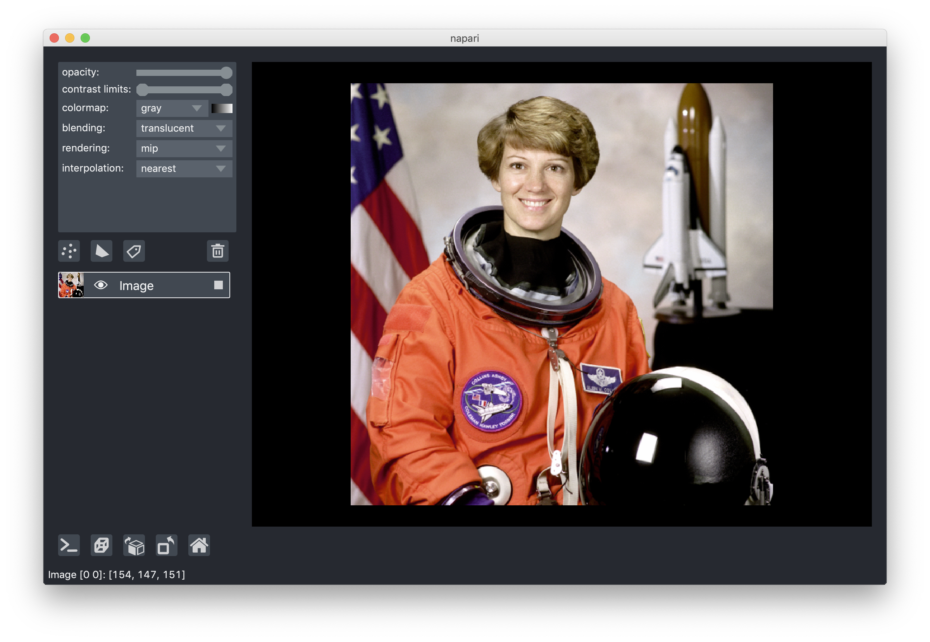
Plan for Today
Overview
Demo/Follow along
Loading multidimensional images
Adding layers
Customizing user interface
Advanced features:
Dask/Zarr for large volumes
Plugins – Napari Hub

Slide 3
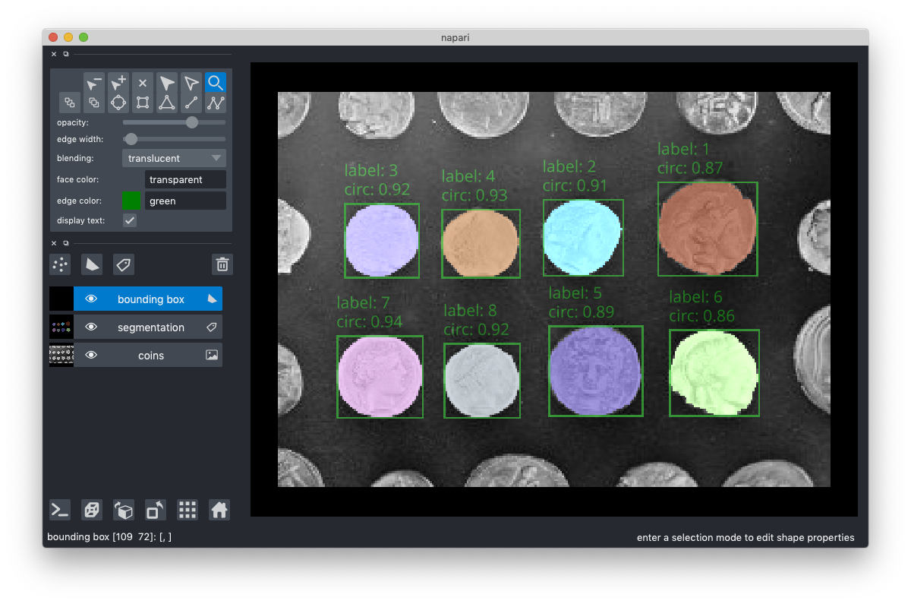
Why Napari?
Programmable w/ Python
Multidimensional image support (3D, 4D, 5D images)
Fast: PyQT GUI, GPU support
Support for layers
Support for distributed, out-of-memory computing through dask and zarr
Customizable interface, easy to add functionalities
Extensible through plug-ins, Napari Hub

Slide 4
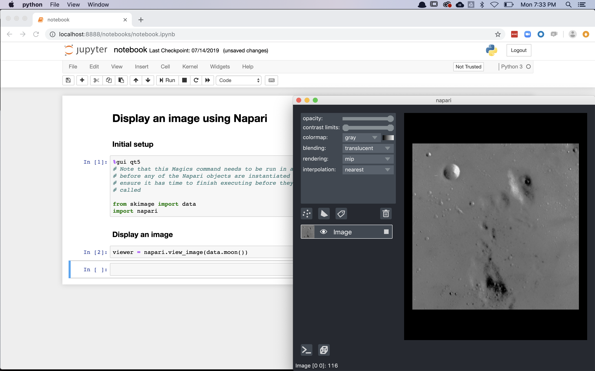
Using Napari
Standalone App (all platforms)
Python Script
IPython/Jupyter
pip install napari[all]
conda install –c conda-forge napari

Slide 5

Note on using Napari on Oscar
Works:
VNC (deprecating soon)
Open OnDemand Desktop
Not working:
command line
Open OnDemand Jupyter Notebooks

Slide 6
Follow along:
Go to https://ood.ccv.brown.edu
Click on Desktop
Choose a non-GPU instance (e.g. 4 Cores, 15GB)
Click Launch
Clone this repo: https://github.com/brown-ccv/DSCoV-NapariWorkshop
In the repo directory, type bash load_env.sh
Launch Jupyter notbook/lab jupyter lab or jupyter notebook
Open demo.ipynb

